Slide 1
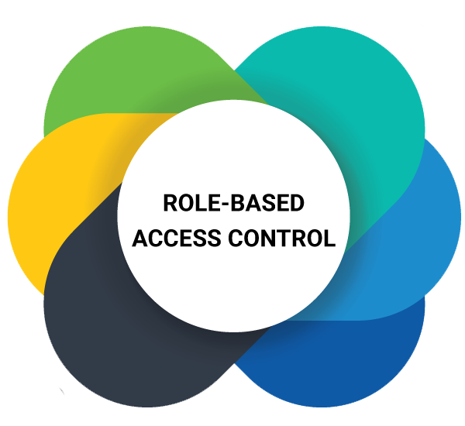

Slide 2
About Today…
Authentication
Role-based Access Control

Slide 3

Role-based
Access
Control

Slide 4
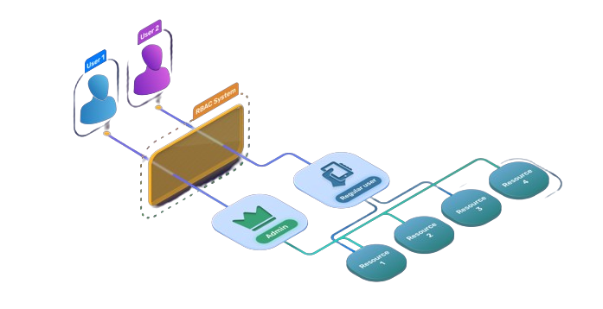
Introduction to RBAC
Definition
A method of regulating access to resources based on the roles of individual users within an organization
Importance
Ensures users have only the permissions necessary to perform their roles

Slide 5
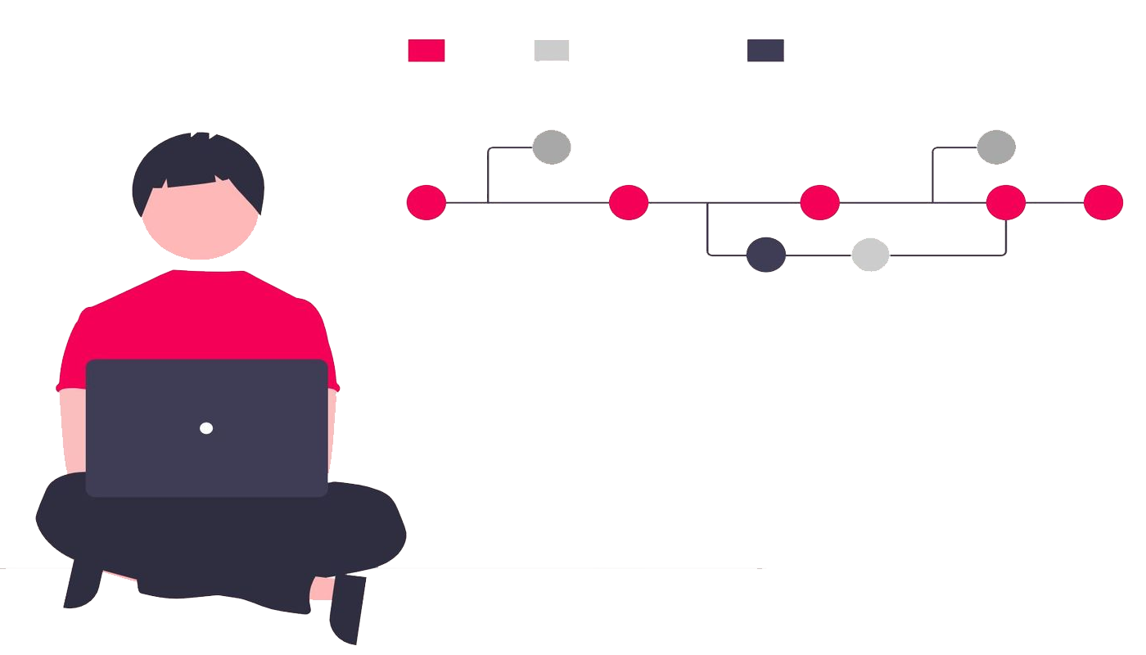
Key Concepts of RBAC
Role
A collection of permissions
Permission
Authorization to perform an action
User
An individual who has one or more roles
Role Assignment
Users are assigned roles
Role Authorization
Roles are granted permissions

Slide 6
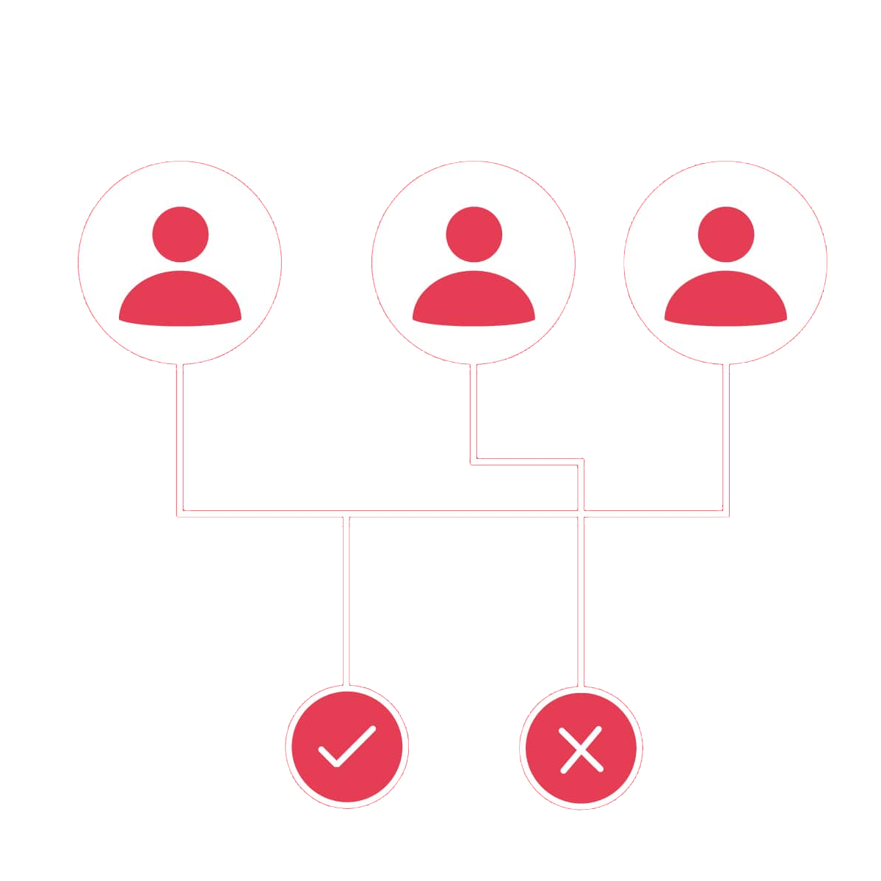
Benefits of RBAC
Simplifies management of user permissions
Enhances security by ensuring least privilege
Easier to audit and comply with regulations
Reduces administrative workload

Slide 7
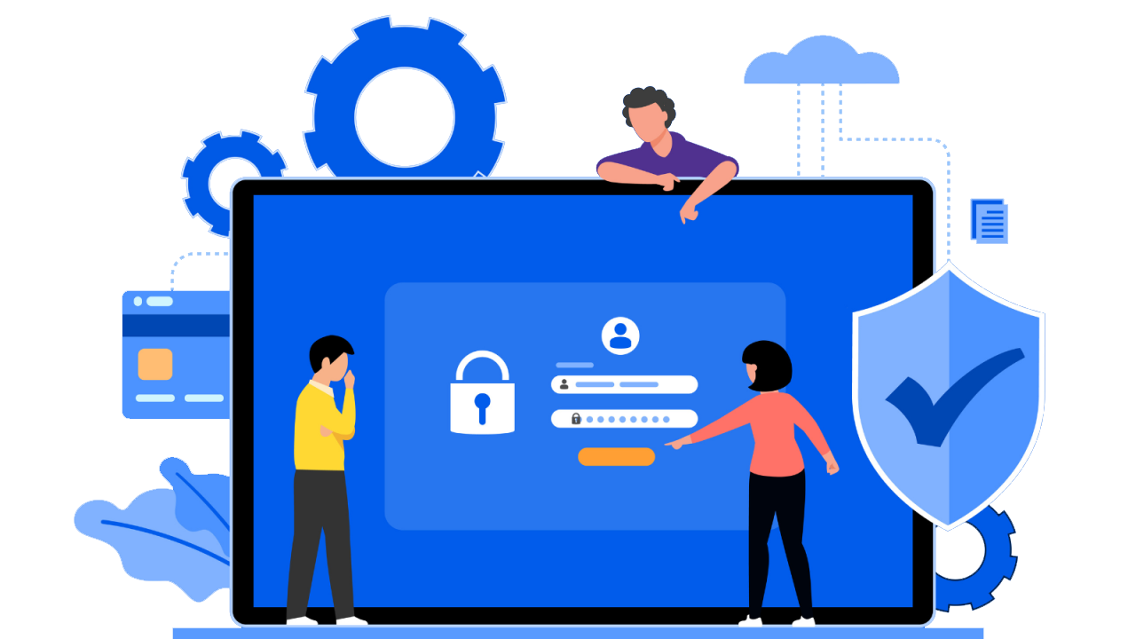
Basic RBAC Model
User
John, Mary
Role
Admin, Editor, Viewer
Permission
Create, Read, Update, Delete

Slide 8

Example Scenario
Admin Role
Permissions
Create, Read, Update, Delete
Editor Role
Permissions
Create, Read, Update
Viewer Role
Permissions
Read

Slide 9
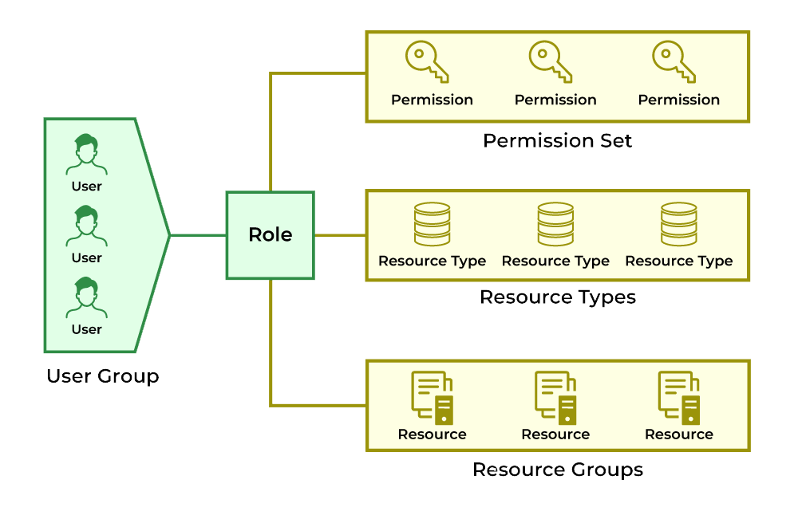
Implementing RBAC
Define roles and permissions
Assign roles to users
Check permissions during access requests

Slide 10

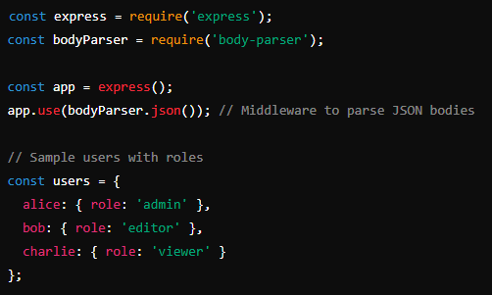
Simple RBAC Implementation
Setup
Install necessary packages
Initial Setup

Slide 11
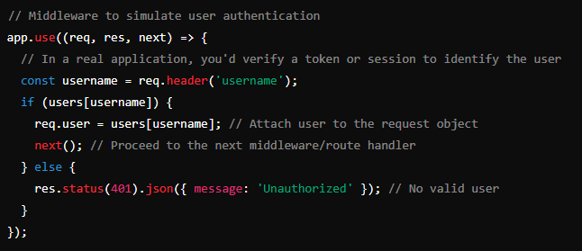
Authentication Middleware
Simulate User Authentication

Slide 12
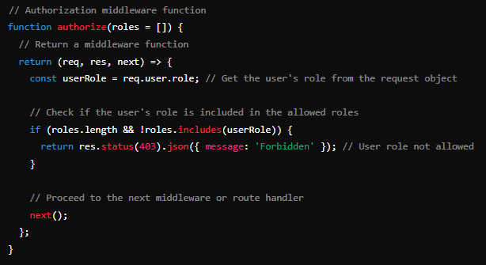
Authentication Middleware
Authorization Middleware Function

Slide 13
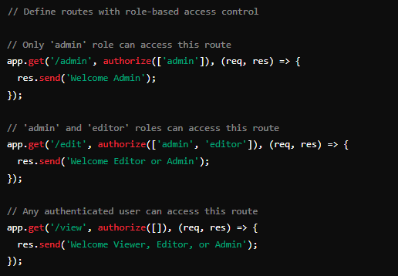
Define Routes with RBAC
Define Routes with Role-based Access Control

Slide 14
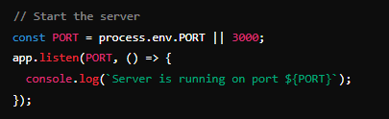
Start the Server
Starting the Server

Slide 15
Testing RBAC
How to Test
Use tools like Postman to send requests with different username headers
Examples
GET /admin
username: alice
Welcome Admin
GET /admin
username: bob
Forbidden
GET /admin
username: charlie
Forbidden
GET /edit
username: alice
Welcome Editor or Admin
GET /edit
username: bob
Welcome Editor or Admin
GET /edit
username: charlie
Forbidden
GET /view
username: alice
Welcome Viewer, Editor, or Admin
GET /view
username: bob
Welcome Viewer, Editor, or Admin
GET /view
username: charlie
Welcome Viewer, Editor, or Admin

Slide 16
Testing RBAC
How to Test
Use tools like Postman to send requests with different username headers
Examples
GET /admin
username: alice
Welcome Admin
GET /admin
username: bob
Forbidden
GET /admin
username: charlie
Forbidden
GET /edit
username: alice
Welcome Editor or Admin
GET /edit
username: bob
Welcome Editor or Admin
GET /edit
username: charlie
Forbidden
GET /view
username: alice
Welcome Viewer, Editor, or Admin
GET /view
username: bob
Welcome Viewer, Editor, or Admin
GET /view
username: charlie
Welcome Viewer, Editor, or Admin

Slide 17
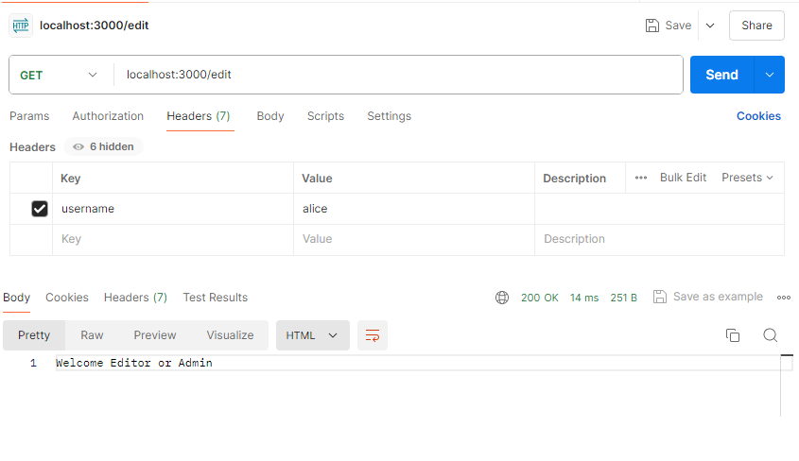
POSTMAN
Success

Slide 18
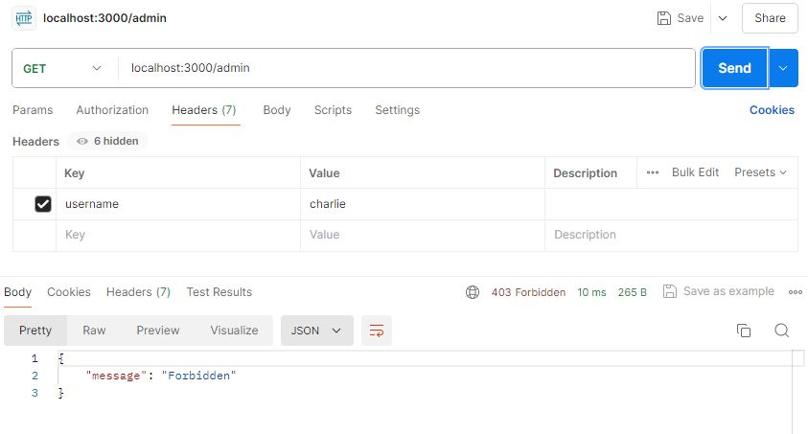
POSTMAN
Failure

Slide 19

What does RBAC stand for?
Role-based Access Control
Name three key concepts of RBAC
Role, Permission, User
What is the main benefit of using RBAC?
Simplifies management of user permissions and enhances security by ensuring least privilege
In RBAC, what does a 'Role' represent?
A collection of permissions
What HTTP status code is typically returned when a user is forbidden from accessing a resource due to insufficient permissions?
403 Forbidden

Slide 20

Task
Create a role based authorization app which prints message according to the role

